Slide 1









Whiteboardmaths.com
7
2
1
5
© 2004 All rights reserved

Slide 2
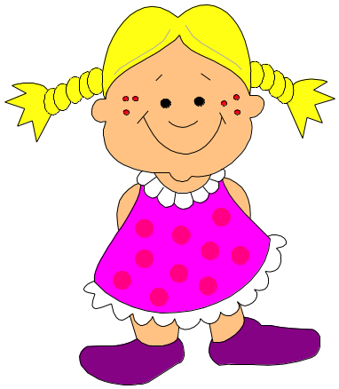
Similarity
B
A
Remember, similar shapes are always in proportion to each other. There is no distortion between them.
C
D
A
B
C
D

Slide 3
Conditions for similarity
Two shapes are similar only when:
Corresponding sides are in proportion and
Corresponding angles are equal
All regular polygons are similar

Slide 5

Conditions for similarity
Two shapes are similar only when:
Corresponding sides are in proportion and
Corresponding angles are equal
All rectangles are not similar to one another since only condition 2 is true.

Slide 6
If two objects are similar then one is an enlargement of the other
The rectangles below are similar:
Find the scale factor of enlargement that maps A to B
8 cm
Not to scale!
5 cm
A
16 cm
Scale factor = x2. (Note that B to A would be x ½)
10 cm
B

Slide 7
If two objects are similar then one is an enlargement of the other
The rectangles below are similar:
Find the scale factor of enlargement that maps A to B
8 cm
Not to scale!
5 cm
A
12 cm
Scale factor = x1½ (Note that B to A would be x 2/3)
7½ cm
B

Slide 8
If we are told that two objects are similar and we can find the scale factor of enlargement by comparing corresponding sides then we can calculate the value of an unknown side.
12½ cm
The 3 rectangles are similar. Find the unknown sides, p and q
Not to scale!
p cm
2 cm
q cm
C
B
24 cm
A
8 cm
1. Comparing corresponding sides in A and B.
SF = 24/8 = x3.
2. Apply the scale factor to find the unknown side.
p = 3 x 2 = 6 cm.

Slide 9
If we are told that two objects are similar and we can find the scale factor of enlargement by comparing corresponding sides then we can calculate the value of an unknown side.
12½ cm
The 3 rectangles are similar. Find the unknown sides, p and q.
Not to scale!
p cm
2 cm
q cm
C
B
24 cm
A
8 cm
1. Comparing corresponding sides in A and C.
SF = 12.5/2 = x6.25.
2. Apply the scale factor to find the unknown side.
q = 6.25 x 8 = 50 cm.

Slide 10

If we are told that two objects are similar and we can find the scale factor of enlargement by comparing corresponding sides then we can calculate the value of an unknown side.
q cm
The 3 rectangles are similar. Find the unknown sides p and q
Not to scale!
7.14 cm
2.1 cm
35.5 cm
C
B
p cm
A
5 cm
1. Comparing corresponding sides in A and B.
SF = 7.14/2.1 = x3.4.
2. Apply the scale factor to find the unknown side.
p = 3.4 x 5 = 17 cm.

Slide 11
If we are told that two objects are similar and we can find the scale factor of enlargement by comparing corresponding sides then we can calculate the value of an unknown side.
q cm
The 3 rectangles are similar. Find the unknown sides p and q
Not to scale!
7.14 cm
2.1 cm
35.5 cm
C
B
p cm
A
5 cm
1. Comparing corresponding sides in A and C.
SF = 35.5/5 = x7.1.
2. Apply the scale factor to find the unknown side.
q = 7.1 x 2.1 = 14.91 cm

Slide 12
Similar Triangles
Similar triangles are important in mathematics and their application can be used to solve a wide variety of problems.
The two conditions for similarity between shapes as we have seen earlier are:
Corresponding sides are in proportion and
Corresponding angles are equal
Triangles are the exception to this rule.
Only the second condition is needed
Two triangles are similar if their
Corresponding angles are equal

Slide 13
These two triangles are similar since they are equiangular.
65º
70º
45º
70º
45º
50º
50º
55º
75º
These two triangles are similar since they are equiangular.
If 2 triangles have 2 angles the same then they must be equiangular
= 180 – 125 = 55

Slide 14
Finding Unknown Sides
b
20 cm
c
6 cm
15 cm
12 cm
Since the triangles are equiangular they are similar.
So comparing corresponding sides to find the scale factor of enlargement.
SF = 15/12 = x1.25.
c = 20/1.25 = 16 cm
b = 1.25 x 6 = 7.5 cm

Slide 15
Finding Unknown Sides
31.5 cm
y
x
6 cm
14 cm
8 cm
Since the triangles are equiangular they are similar.
So comparing corresponding sides to find the scale factor of enlargement.
SF = 14/8 = x1.75.
y = 31.5/1.75 = 18 cm
x = 1.75 x 6 = 10.5 cm

Slide 16
Determining similarity
A
B
Triangles ABC and DEC are similar. Why?
C
Angle ACB = angle ECD (Vertically Opposite)
Angle ABC = angle DEC (Alt angles)
E
D
Angle BAC = angle EDC (Alt angles)
Since
ABC
is similar to
DEC
we know that corresponding sides are in proportion
AB→DE
BC→EC
AC→DC
The order of the lettering is important in order to show which pairs of sides correspond.

Slide 17
If BC is parallel to DE, explain why triangles ABC and ADE are similar
A
Angle BAC = angle DAE (common to both triangles)
B
C
Angle ABC = angle ADE (corresponding angles between parallels)
D
E
Angle ACB = angle AED (corresponding angles between parallels)
A line drawn parallel to any side of a triangle produces 2 similar triangles.
A
A
B
B
D
E
D
E
C
C
Triangles EBC and EAD are similar
Triangles DBC and DAE are similar

Slide 18


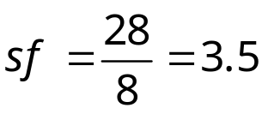

A tree 5m high casts a shadow 8 m long. Find the height of a tree casting a shadow 28 m long.
Example Problem 1
5m
h
8m
Explain why the triangles must be similar.
28m

Slide 19
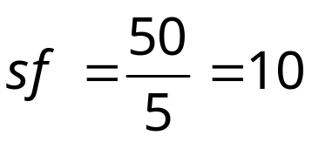
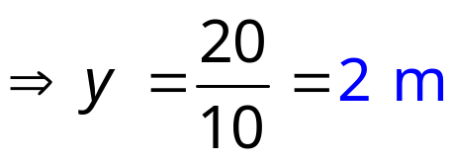
Example Problem 2
The two triangles below are similar: Find the distance y.
C
B
20m
y
A
5m
E
45m
D

Slide 20
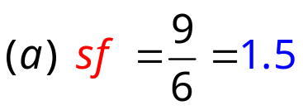



Example Problem 3
In the diagram below BE is parallel to CD and all measurements are as shown.
Calculate the length CD
Calculate the perimeter of the Trapezium EBCD
A
A
4.2 m
6 m
6.3m
9 m
B
E
4.8 m
2.1 m
3 m
C
D
7.2m
C
7.2m
D

